Slide 1
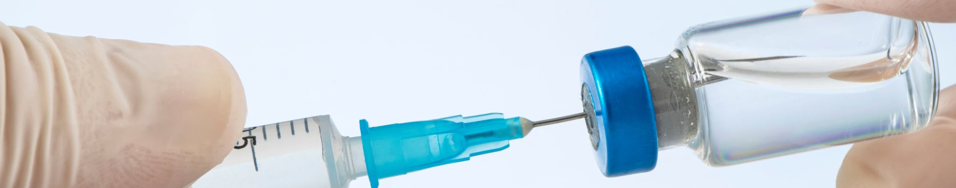
VACCINES
Fact vs Fiction
Dawn of Misinformation
06.16.25
FACTCHECK MD
PRESENTED BY:
Rami T. Ezzeddine & Giovanni Chahine
Notes:
Welcome! An educational, neutral look at vaccine science and myths
Goal: Empower with facts, debunk fiction
Discussion at the end so if you have any questions please let us know at the end thanks so much for having us
Blur faces out if you want
We’re both fourth year biology undergraduate students and our mission here is to make medical information more accessible
Hopes of bringing light to certain topics and having open discussion
Skepticism around science has intensified lately and this is helpful for community

Slide 2
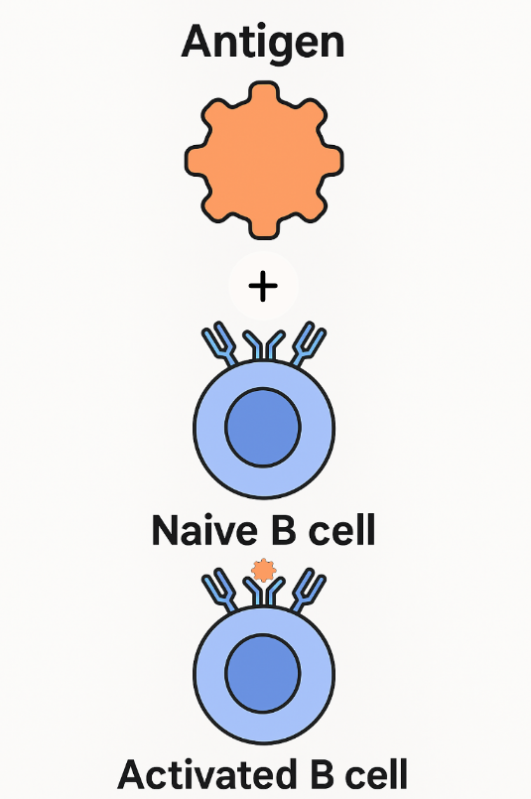
What are Vaccines?
Definition
A form of medication which trains your immune system to fight a disease without causing the illness
Mechanism of Action
They introduce a harmless form of a germ so your body learns to recognize and destroy the real germ later
Immune Memory
After vaccination, the body makes memory cells and antibodies that quickly attack if the germ is to reappear in its active/threatening form
Notes:
Before we can get into some of the misconceptions and truths surrounding vaccines, first, we should know what they are and how they work
. Because, believe me, I had no idea until just a few years ago and whenever they tried explaining how it worked it was honestly was not very helpful to me
I was a former skeptic and still try to be a skeptic today because there is nothing 100% in a field as actively developing as vaccine science but without further ado let’s get into this

Slide 3
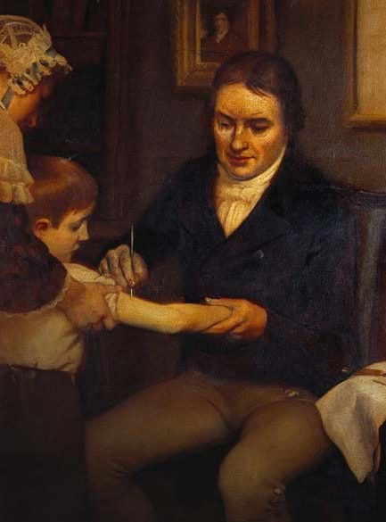
History of Vaccines
Variolation
As early as 1000 BC; pus, scabs, and other things from sick individuals were either eaten by or injected into healthy people so that their bodies could prepare for the real thing
Landmark Vaccines
Edward Jenner’s cowpox vaccine for smallpox
Jonas Salk’s vaccine with inactive Polio virus that could not replicate and infect a person but still allowed for the immune system to recognize it
Modern Vaccines
1986: Hepatitis B Vaccine
2006: HPV Vaccine
2006: TDAP Vaccine
Notes:
Side effect of variolation is that some people ended up actually contracting the disease whcih is why this is no longer in practice today because with modern vaccines the virus is weakened in a lab making it harmless first to avoid this risk before injecting it into the person
Famously, Davy Crockett was not allowed to play outside since there was an ongoing smallpox epidemic so he slept next to his friend who was infected with it so that he could get sick, recover from it, and then no longer live in fear of it.
Of course, we do not recommend you do the same thing with your sick relatives but you can see the basic principle in action back then.
“As smooth as a milkmaid’s skin,” gave him the idea
Hepatits B: First vaccine made using genetic engineering. Scientists inserted the gene for the Hep B surface antigen (HBsAg) into yeast cells, which then mass-produced the protein.
HPV: First vaccine that prevent a STD and even a certain form of cancer associated with.
DTaP is a childhood vaccine that protects against diphtheria, tetanus, and pertussis (whooping cough) using full-strength, purified antigens to safely build immunity in infants and young children.
TDAP Vaccine: booster vaccine for teens and adults that protects against tetanus, diphtheria, and whooping cough (pertussis) using reduced doses of the antigens found in the childhood DTaP vaccine.
Reprime the body to be able to fend off these historically very deadly diseases

Slide 4
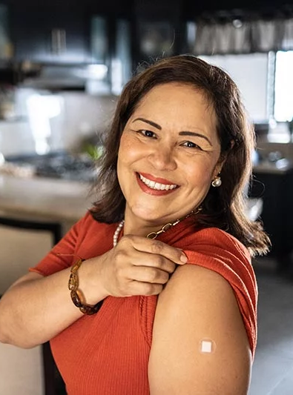
What Makes a Vaccine Effective?
SAFE
Vaccine itself must not itself cause illness or death
PROTECTIVE
Vaccine must protect against illness resulting from exposure to live pathogen
SUSTAINED PROTECTION
Protection against illness must last for several years
PRACTICALITY
Must be inexpensive for patient, be easy to administer, and have few side-effects
Notes:
Easy to nasally take, intravenously take, or orally take
18 years on average to be approved by CEC

Slide 5
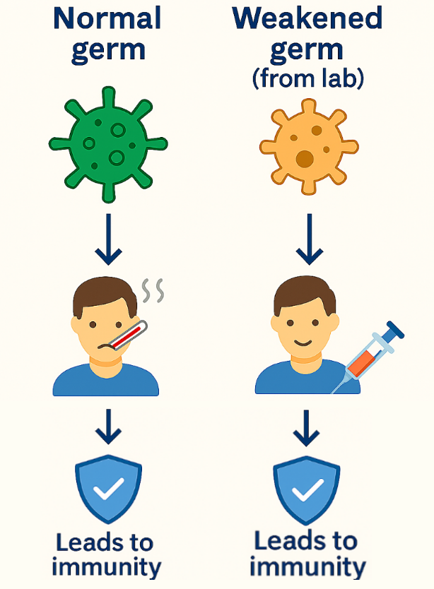
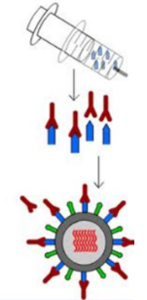
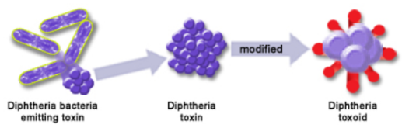
Types of Vaccines
Weakened or Inactive Germ Vaccine
EIther a weakened or dead/inactivated whole bacteria or virus is injected into the body as a “training dummy” for the body to get used to
Most effective vaccine but also highest chance of side effects
Subunit Vaccine
Rather than the entire germ be injected, a small piece of it such as a viral spike
Toxoid Vaccine
Some disease-causing bacteria release exotoxins
Toxoid vaccines chemically modify the exotoxins turning them into “toxoids” which can be adapted to by the body
Notes:
So we know now that vaccines are not this kind of new-fangled technology but rather a tried and true method that has been in use for hundreds of years if not longer based on the principle of getting your body used to a weaker germ before the real one comes along kind of like boxing with your trainer who you know isn’t going to hurt you before actually getting into a big fight with the designated opponent
WHat this shows is that there are many different types of vaccines with tradeoffs in terms of effectiveness and safety; not that any of them are unsafe because in that case they would never be approved by the CDC in the first place which is itself a rigorous process but it allows for a healthcare provider to make decisions based on the patient profile
There are many more but these are some of the main ones
Weakend/Inactive
since what if the virus recovers while it is still in your body?
Like for pregnant women or people with particularly weak immune systems
Something that your healthcare provider will always take into account before recommending any sort of vaccine

Slide 6
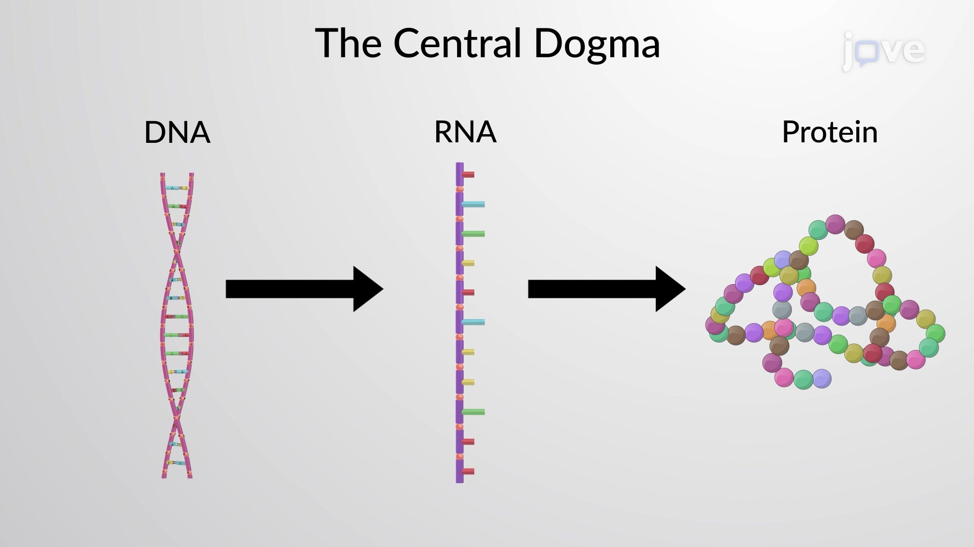
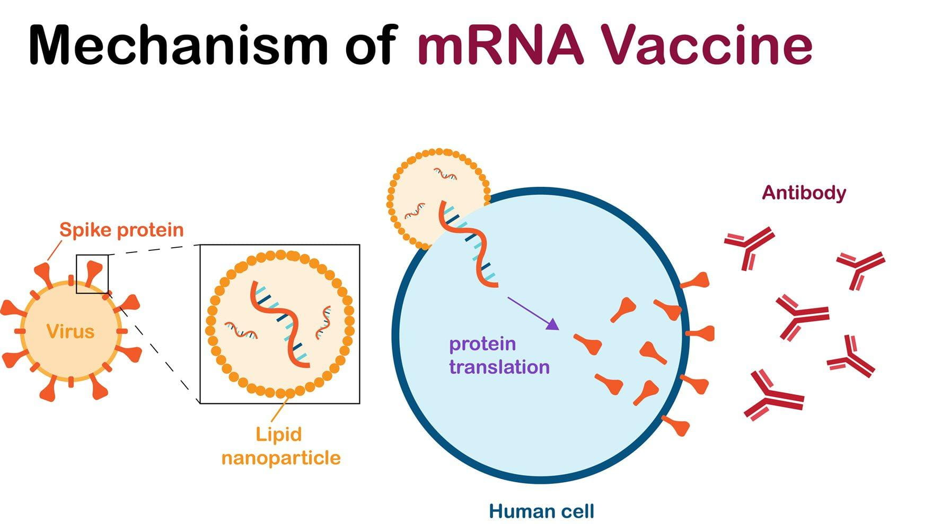
What exactly is mRNA?
Central Dogma
DNA is the architect’s master plan
RNA is the construction blueprint for a specific house
Protein is the actual building built from the blueprint with a specific function
mRNA Technology
Similar to subunit vaccine in that we use a harmless but recognizable part of a virus for body to adapt to
The twist is we let our body make that part of the virus by giving it the blueprint to make that “viral spike” on its own then recognize it for the real thing
mRNA in Vaccines
While the technology was indeed authorized for the first time for human use in 2020, the whole concept of the central dogma has been known since 1961
mRNA was theorized to be used therapeutically since the 1970s but at the time it was too difficult to stabilize
The Moderna and Pfizer COVID vaccines both work this way, and currently, vaccines for Zika, flu, and rabies are in development
Notes:
Central Dogma: Plan to build a new Metropolis
mRNA main form of RNA, m stands for “messenger” RNA
Protein can have a variety of functions depending on blueprint/RNA, can be house for people, can be factory for making products, can be resort for relaxing
Analogy: Instead of buying a body bag to train with, you make your own
You let your body make something naturally, the more we stay in line with natural processes the less likely to have side effects

Slide 7
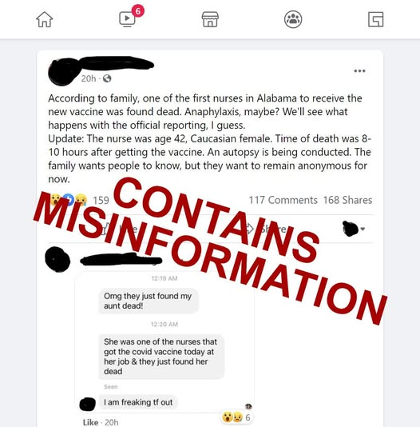
Misconceptions
Outlets of the Spread
WhatsApp, Facebook, Instagram, Twitter posts; all vectors of misinformation
Mixing Faith with Misinformation
Make it seem as though vaccines are fulfilling an end-time prophecy when the two are not necessarily related
Well-intended but spread false information whether positive or negative
Why Do Some People Avoid Vaccines
Mercury and other heavy metals as ingredients
Cases when vaccines were withdrawn
Vaccines are “unnatural” and “cause autism”
Notes:
CDC constantly changing narrative not to lie or for agenda but because of changing science
Guillain Barre 1 in 100k chance in Johnson and Johnson but still enough to get it pulled

Slide 8
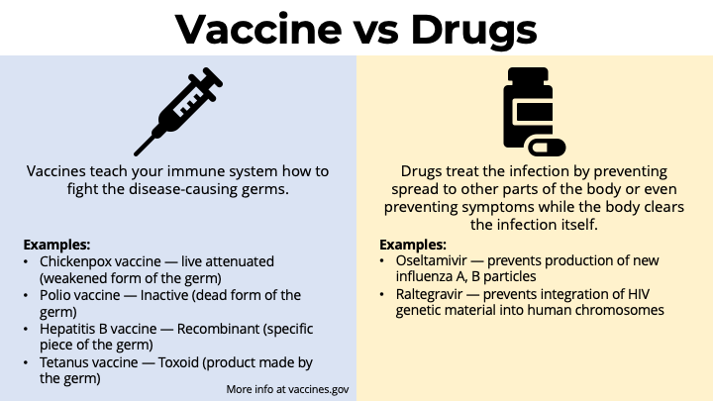
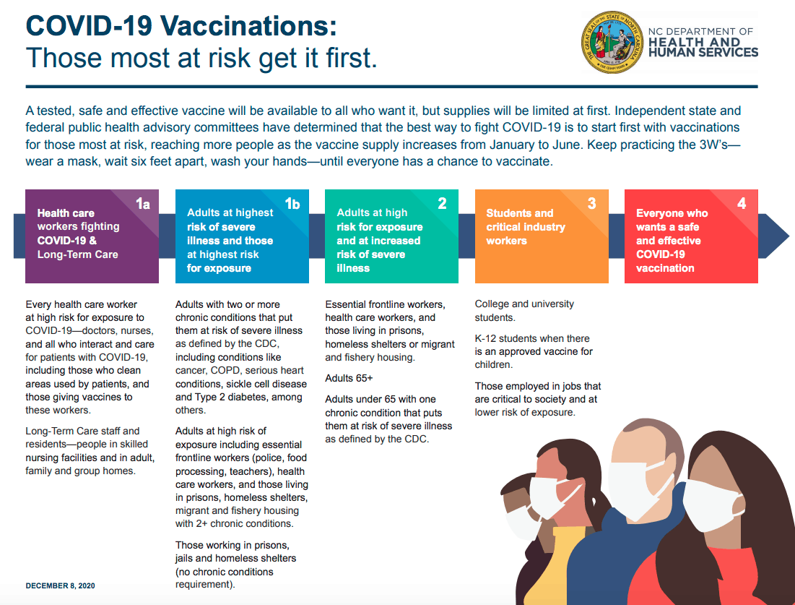
Risk/Benefit Analysis
Vaccines vs Drugs
Both are engineered with the intention of improving the quality of life, yet both have side effects involved.
Which patient populations are considered Essential?
Immunocompromised individuals
Adults aged 65 and over.
Verdict:
The benefits outweigh the risks given the statistical significance.
Notes:
CDC constantly changing narrative not to lie or for agenda but because of changing science
18 years usually for vaccine to be approved by the CDC

Slide 9
INFORMATIONAL
EPIDEMIC
50%
51%
15%
A combination of digital platform negligence, rising distrust in institutions, and the accelerating spread of conspiratorial narratives has severely undermined America's public health resilience.
of Americans believe that vaccines alter your DNA
LOWER risk of SIDS in vaccinated infants compared to non-vaccinated ones
of vaccine-related social media posts are false or misleading
Notes:
COMMON MISCONCEPTIONS HERE
Causing autism because of mercury
Other things

Slide 10
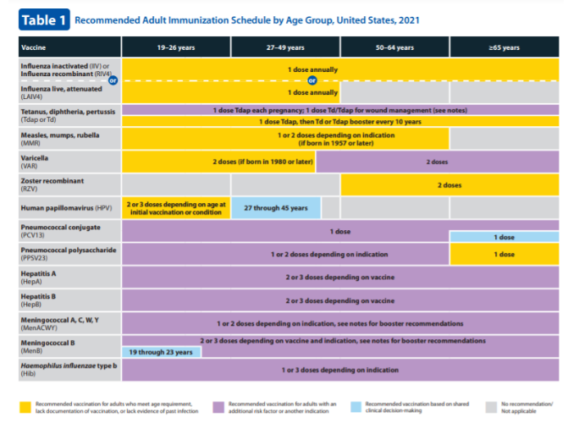
Resources for Reassurance
Center for Disease Control (CDC)
Vaccine schedules, safety info, and data tracking
WHO
Global vaccine facts, myth debunking, multilingual guides
Children’s Hospital of Philadelphia (CHOP)
Run by non-governmental pediatrician who breaks down vaccine topics in clear, family-friendly language
MyTurn California
Connects Californians to vaccine appointments statewide
Diversity/Minority-Focused Groups
Latino Coalition for a Healthy California
Asian Pacific Health Corps
CDC Adult Immunization Schedule
Notes:
CDC constantly changing narrative not to lie or for agenda but because of changing science
Adult immunization schedule (CDC)
My Turn California
Originally built for COVID vaccines but now connects Californians to vaccine appointments statewide (COVID, flu, etc.)
User-friendly, mobile-friendly, available in 13+ languages
Latino
Vaccine myth-busting workshops
Collaborations with promotoras de salud (community health workers)
Policy advocacy to ensure vaccine access and educatio
Asian
Free vaccine education workshops
Translated materials in Chinese, Korean, Tagalog, etc.
Focus on intergenerational trust-building

Slide 11



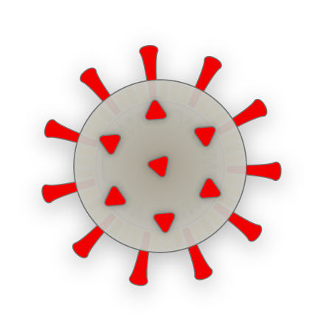
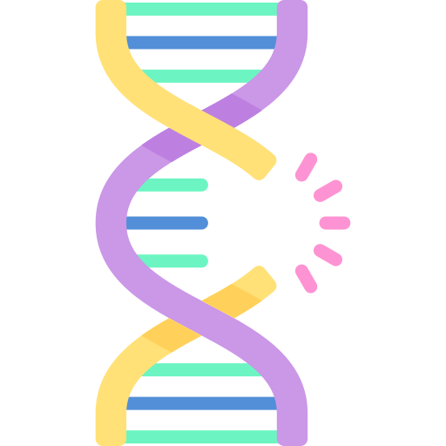

COVID Vaccine CDC/WHO Messaging
TIMELINE
2020 2021 2022
FAST-TRACKED APPROVAL
TOTAL PROTECTION?
VIRUS MUTATION
MASK MANDATE LIFTED
Pfizer & Moderna report ~95% efficacy in preventing symptomatic COVID.
CDC: “Vaccines prevent COVID-19,” stopping infection and not just disease
Cases of vaccinated individuals testing positive for COVID-19
CDC: “Vaccines don’t prevent contraction of COVID, but prevent symptoms.”
Mutating strains such as Delta and Omicron variants means that mRNA vaccine of original variant no longer as effective as they once were
CDC: “Vaccines don’t prevent symptoms, but prevent life-threatening ones.”
COVID no longer declared a Public Health Emergency by WHO.
CDC recommends boosters primarily for high-risk groups (65+, immunocompromised).
CDC quietly updates guidance: COVID vaccine optional for healthy young adults with prior infection.
Notes:
Does this mean that they are lying?’
Dr Fauci was not some bum, he was an established doctor and identified and fought gainst AIDS way back when too
No, if they wanted to lie then they would have simply stated from teh beginning that it was 100% effective and never changed the narrative on it; the fact that it was constantly shifting/changing shows that based on where we were at in terms of the situation, science, and technology that the public would be updated.

Slide 12
REFERENCES
Business Insider. (2021, July 7). 20% of Americans believe microchips are in COVID‑19 vaccines. Business Insider. https://www.businessinsider.com/americans-believe-covid-vaccine-microchip-theory-survey-2021-7
Basch, C. H., Hillyer, G. C., Meleo-Erwin, Z., Zagnit, E. A., & Basch, C. E. (2021). Characterizing COVID-19 content posted to TikTok: Public sentiment and response during the first phase of the COVID-19 pandemic. Journal of Preventive Medicine and Public Health, 54(3), 147–152. https://www.researchgate.net/publication/352646970_Characterizing_COVID-19_Content_Posted_to_TikTok_Public_Sentiment_and_Response_During_the_First_Phase_of_the_COVID-19_Pandemic
Centers for Disease Control and Prevention. (n.d.). COVID‑19 Vaccine Basics. CDC.gov. https://www.cdc.gov/coronavirus/2019-ncov/vaccines/keythingstoknow.html
Centers for Disease Control and Prevention. (n.d.). Staying Up to Date with COVID‑19 Vaccines. CDC.gov. https://www.cdc.gov/coronavirus/2019-ncov/vaccines/stay-up-to-date.html
Centers for Disease Control and Prevention. (2024). Vaccines and Immunizations. CDC.gov. https://www.cdc.gov/vaccines
Children’s Hospital of Philadelphia. (n.d.). Vaccine Education Center. CHOP.edu. https://www.chop.edu/centers-programs/vaccine-education-center
Latino Coalition for a Healthy California. (n.d.). Vaccine access and health equity. LCHC.org. https://www.lchc.org
Mayo Clinic. (n.d.). History of COVID‑19: Outbreaks and vaccine timeline. Mayo Clinic. https://www.mayoclinic.org/diseases-conditions/coronavirus/in-depth/coronavirus-vaccine/art-20484859
Miami Herald. (2021, July). 1 in 5 Americans believe microchips are hidden in COVID vaccines, poll says. Miami Herald. https://www.miamiherald.com/news/coronavirus/article252636258.html
MyTurn California. (n.d.). Find a COVID‑19 vaccine in California. MyTurn.ca.gov. https://myturn.ca.gov
ScienceDirect. (2023). Development of COVID‑19 vaccine policy — United States, 2020. Vaccine. https://www.sciencedirect.com/science/article/pii/S0264410X21015449
The Economist/YouGov Poll. (2022, August). Which conspiracy theories do Americans believe? YouGov. https://today.yougov.com/politics/articles/43288-conspiracy-theories-beliefs-august-2022
Washington Post. (2025, April 22). Who should get the COVID booster? The advice might soon change. The Washington Post. https://www.washingtonpost.com/health/2025/04/22/covid-booster-guidelines-2025
World Health Organization. (2024). Immunization, vaccines and biologicals. WHO.int. https://www.who.int/health-topics/vaccines

