Slide 1

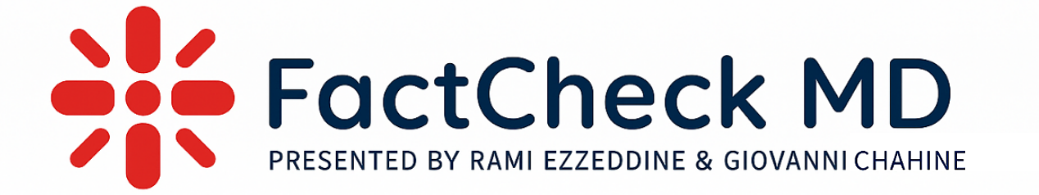
The Truth About Dietary Supplements: Separating Science from Snake Oil
Presented by: Rami T. Ezzeddine
With Contributions From: Giovanni Chahine
Date: April 19, 2025

Slide 2
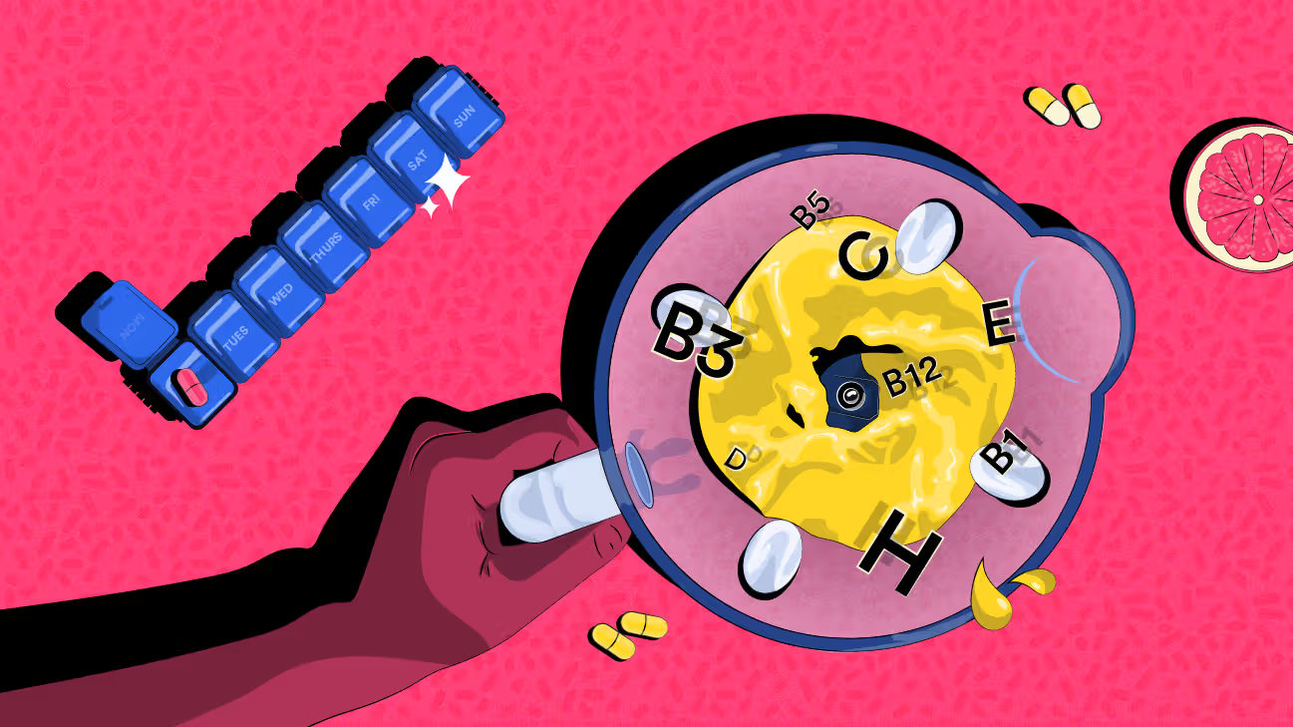
BACKGROUND & SIGNIFICANCE
What are Dietary Supplements?
  Products taken orally that contain a "dietary ingredient" like vitamins, minerals, herbs, amino acids, or enzymes
  Marketed to “supplement” the diet, not to treat or cure disease (NIH, 2024)
Is it Regulated?
  Not approved by the FDA for safety/effectiveness before sale
  Manufacturers are responsible for ensuring product safety and labeling accuracy (FDA, 2023)
What are Common Concerns?
  Risk of contamination or adulteration with unlisted substances
  Potential interactions with medications
Notes:
Supplements are things people take to improve their health
Usually not prescription
Includes vitamins, minerals, herbs, powders, gummies
The FDA doesn’t approve them before they’re sold
They’re regulated more like food than medicine
You don’t need a doctor to get them

Slide 3
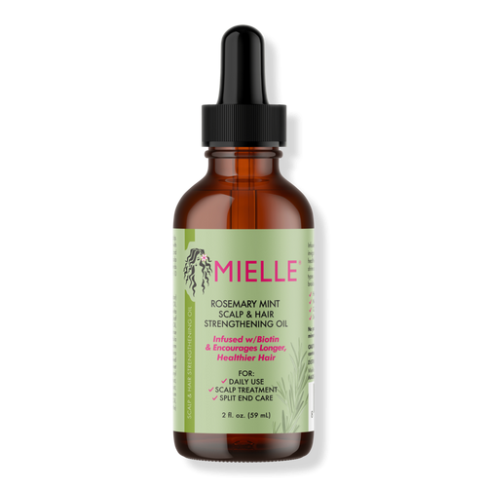
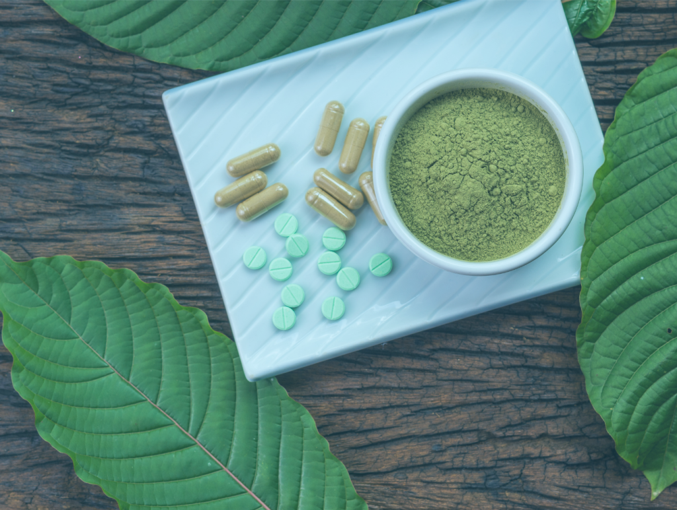
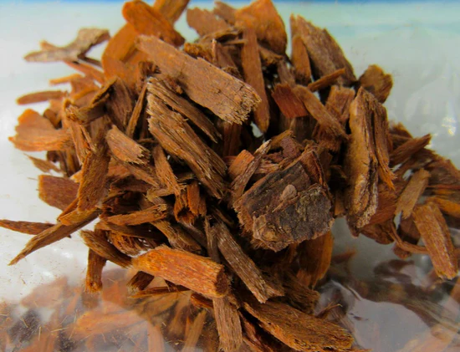
THE TRADEOFF WITH SUPPLEMENTS
Rosemary Oil (for Hair Loss)
  Marketed to stimulate hair growth by improving scalp circulation
  Limited evidence; can cause skin irritation or allergic reactions (NIH, 2024)
Kratom (Mitragyna speciosa)
  Promoted as a “natural pain reliever” or opioid alternative
  Risks include addiction, seizures, liver damage; FDA warns against use (CDC, 2022)
Yohimbe (Pausinystalia johimbe)
  Sold for “male enhancement” and weight loss
  Can cause dangerously high blood pressure, heart problems, and anxiety (NIH, 2023)

Slide 4

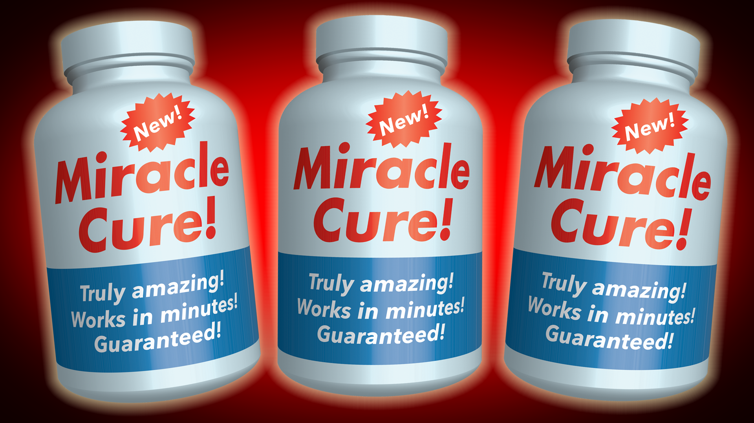
Alternative Medicine or Just Marketing?
How are Supplements Marketed?
  Framed as "natural" alternatives to pharmaceuticals
  Often use vague language: "supports immunity," "promotes vitality," without clinical proof
Common Tactics Utilized
  Celebrity endorsements and social media influencers
  Use of pseudoscience or cherry-picked data (e.g., “studies show” referring to one rat study which becomes a miracle cure)
Why It Matters
  Can delay medical care when people rely on unproven products
  May create false hope for chronic or serious conditions (Mayo Clinic, 2023)
Notes:
Supplements don’t need clinical trials to make claims
They use vague words like “support” and “promote”
There’s a lot of emphasis on being natural
Influencer marketing is common and medical drugs go through a much stricter process The standard of proof is completely different for the two

Slide 5
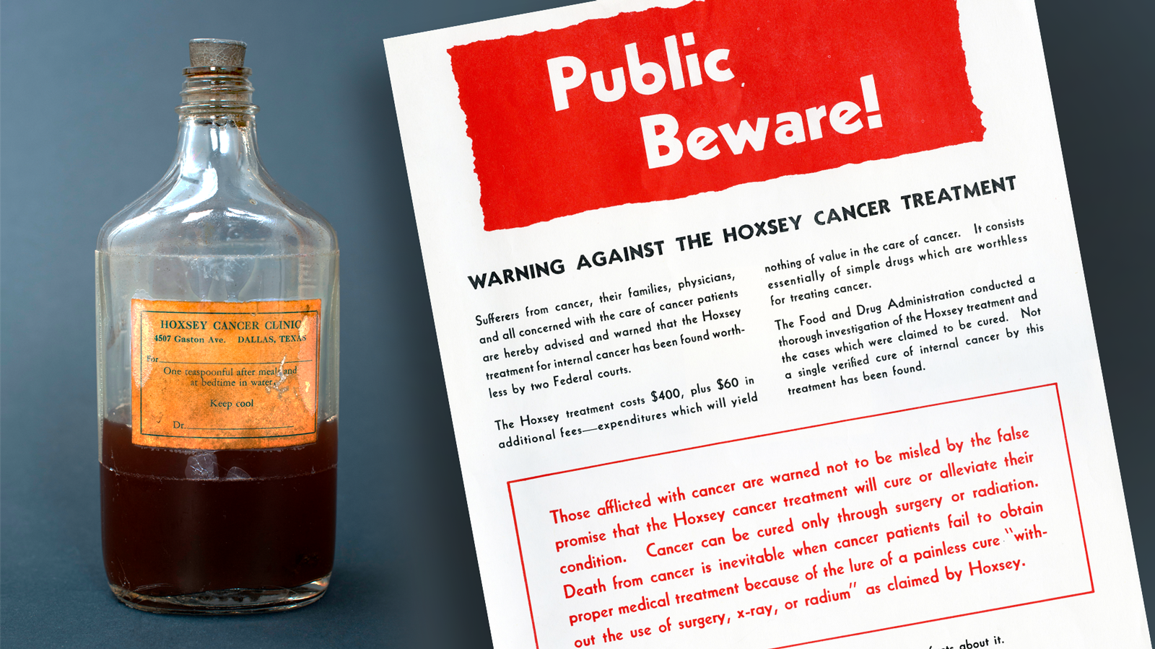
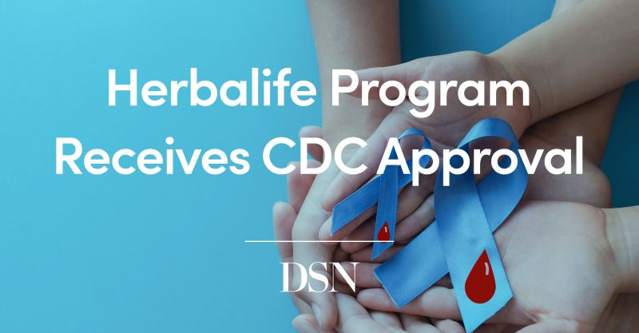
HOW TO SPOT RED FLAGS
Warning Signs of Dubious Supplements
  Claims to “cure all diseases” or work instantly
  Uses “ancient secret” or “miracle” language without evidence
What to Look For Instead
  Look for third-party testing (e.g., USP, NSF).
  Clinical trials listed on trusted databases (like ClinicalTrials.gov).
Advice for Consumers
  Consult with healthcare providers before use.
  Not every supplement is a scam–CDC certified Herbalife as a “diabetes prevention program”
  Just because it’s sold in a store doesn’t mean it’s safe (NIH, 2024)
Notes:
Look out for big promises like “cures everything being cautious if it works “instantly” or has zero side effects
ALWAYS CHECK if it’s been third-party tested
Avoid products that rely only on testimonials like celebrities. Ancient knowledge is what much of modern medicine is built upon anyway…

Slide 6
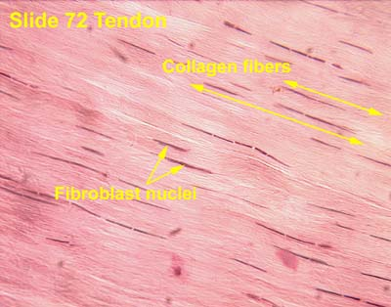
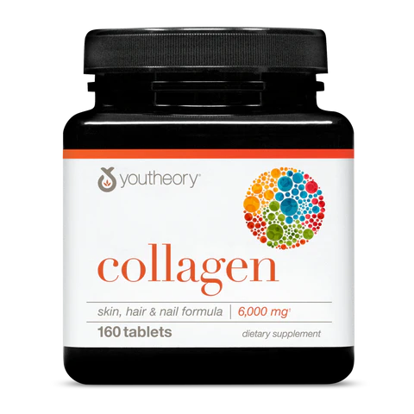
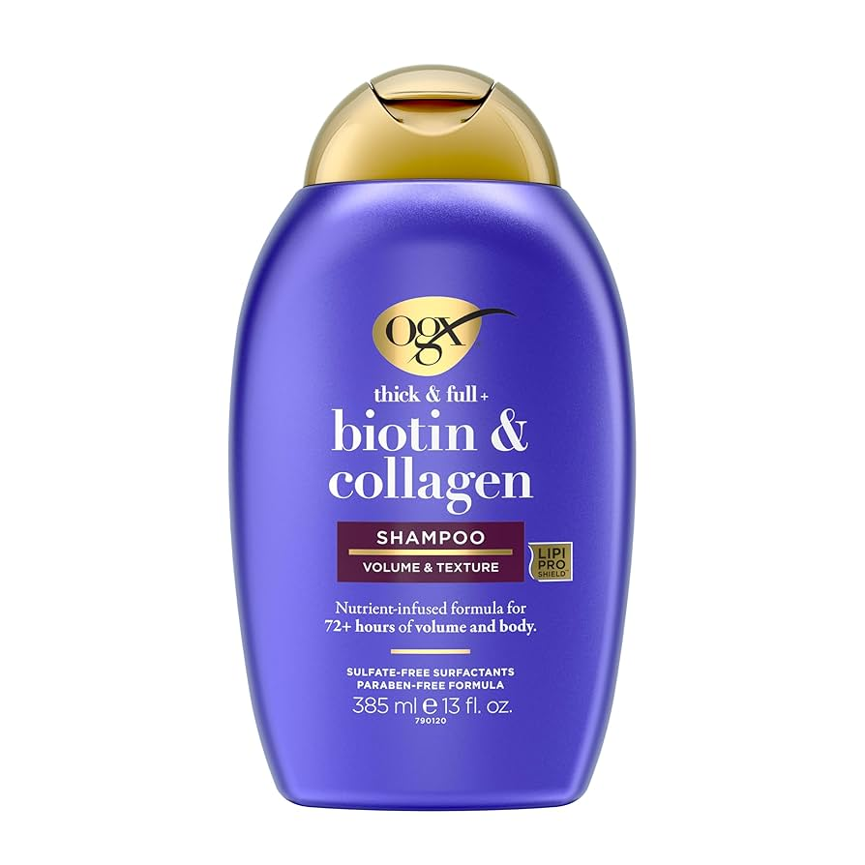
CASE STUDY: THE COLLAGEN CRAZE
What Exactly is Collagen?
  Biological scaffolding, providing strength and elasticity to your skin and joints
  Collagen molecules in creams are too large to penetrate the skin, supplements do not directly go to hair & skin necessarily
Does it Actually Help?
  Some studies show modest improvements in skin elasticity with hydrolyzed collagen
  But effects vary based on dose (marine vs. bovine), and absorption
Hidden Caveats
  Body may not use it for skin
  Expensive for unproven results; many brands lack transparency in sourcing
Notes:
Collagen is a structural protein found in skin and joints and the most abundant one in the body.
Your body breaks collagen into amino acids not send it straight to your skin
Creams with collagen don’t usually work as that is not how collagen absorption works for the most part Some studies show small benefits, but results are mixed and contradictory.
Collagen supplemenrts so ubiquitous they are accepted as fact by many to be beneficial

Slide 7

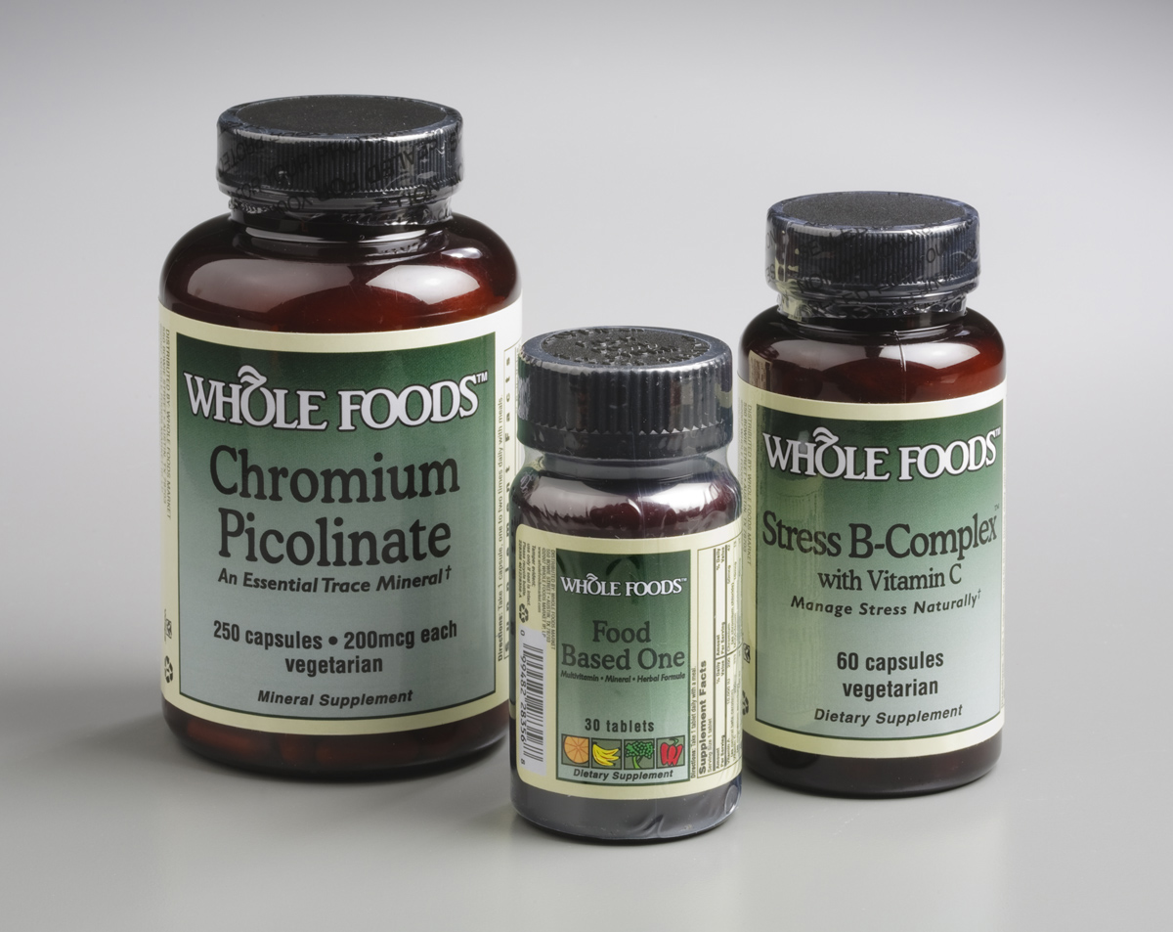
Navigating the Supplement Storm
Key Takeaways & Conclusions
  Supplements are not inherently bad or safe in many instances
  Fact check with reliable resources and healthcare providers before investing
  Natural ≠ harmless; regulation is limited, and marketing often overreaches
How to Research?
  Start With Credible Sources like the NIH, FDA, Mayo Clinic, and even PubMed
  Avoid influencer blogs or product websites selling what they claim to evaluate
  Make sure the studies are human and utilize RCTs as animal ones can be misleading
  Look into the funding of the research and cross-reference
Notes:
Check if the study was done on humans, not just animals, many marked differences
See if the dosage in the study matches the product
Look at who funded the research because many big companies fund for their best interest and not necessarily for the truth, skew data or make conclusions based on mixed evidence Different control and study types

Slide 8
REFERENCES
Cochrane Database of Systematic Reviews. (Various). Systematic reviews on supplements and safety. https://www.cochranelibrary.com
Examine.com. (2024). Collagen: Evidence-Based Overview. https://examine.com/supplements/collagen
Mayo Clinic. (2024). Are dietary supplements safe? https://www.mayoclinic.org
National Institutes of Health. (2023). Dietary Supplements: What You Need to Know. https://ods.od.nih.gov
Palleros, D. R. (2000). Experimental Organic Chemistry (1st ed.). John Wiley & Sons.
Sopena, F., & Lanas, A. (2007). How to advise aspirin use in patients who need NSAIDs. Current Pharmaceutical Design, 13(22), 2248–2260.
Statista. (2024). Collagen Market Size Worldwide. https://www.statista.com
U.S. Food and Drug Administration. (2024). Dietary Supplement Products & Ingredients. https://www.fda.gov

